Slide 1

`
Schulich School of Business MBAN 6110
MODULE : Decision Trees
Data Science I
Instructor: Boris Garbuzov
MBAN 6110
Fall 2020
SCHULICH SCHOOL OF BUSINESS | MBAN 6110
MODULE 1
Data Science I
2020

Slide 2
Outline
The Basics of Decision Trees
Regression Trees
Classification Trees
Pruning Trees
Trees vs. Linear Models
Advantages and Disadvantages of Trees
Ensembles
Bagging
Random forests

Slide 3
Partitioning Up the Predictor Space
One way to make predictions in a regression problem is to divide the predictor space (i.e. all the possible values for for X₁,X₂,…,X_{p}) into distinct regions, say R₁, R₂,…,R_{k}
Then for every X that falls in a particular region (say R_{j}) we make the same prediction,

Slide 4
Regression Trees
Suppose for example we have two regions R₁ and R₂ with
Then for any value of X such that we would predict 10, otherwise if we would predict 20.

Slide 5
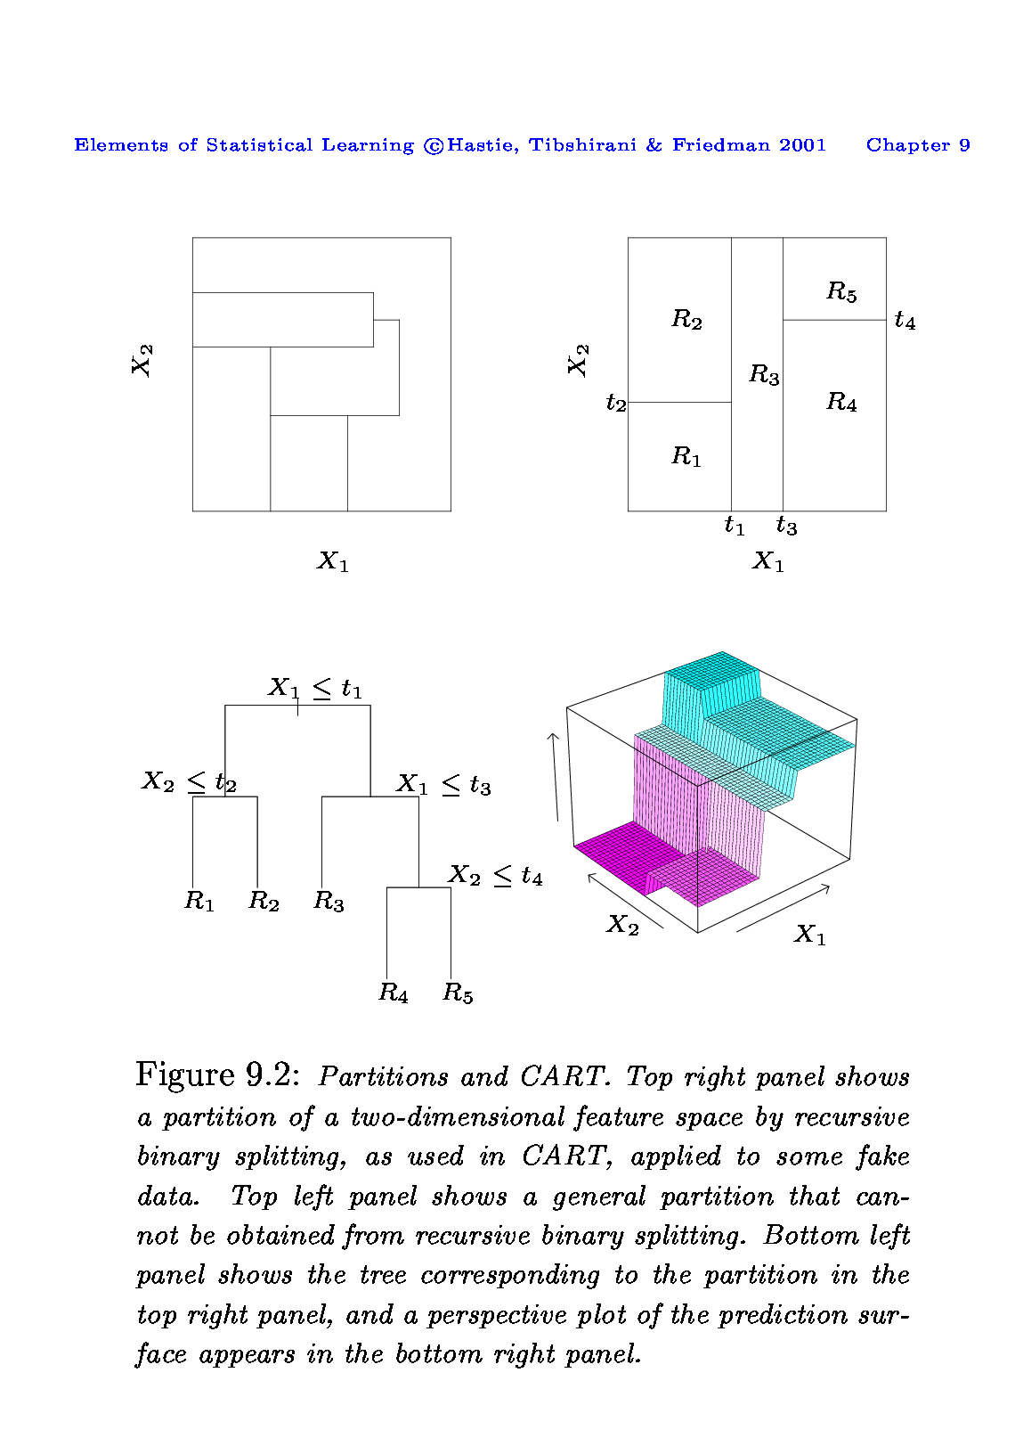
The General View
Here we have two predictors and five distinct regions
Depending on which region our new X comes from we would make one of five possible predictions for Y.
22
12
9
34
23

Slide 6
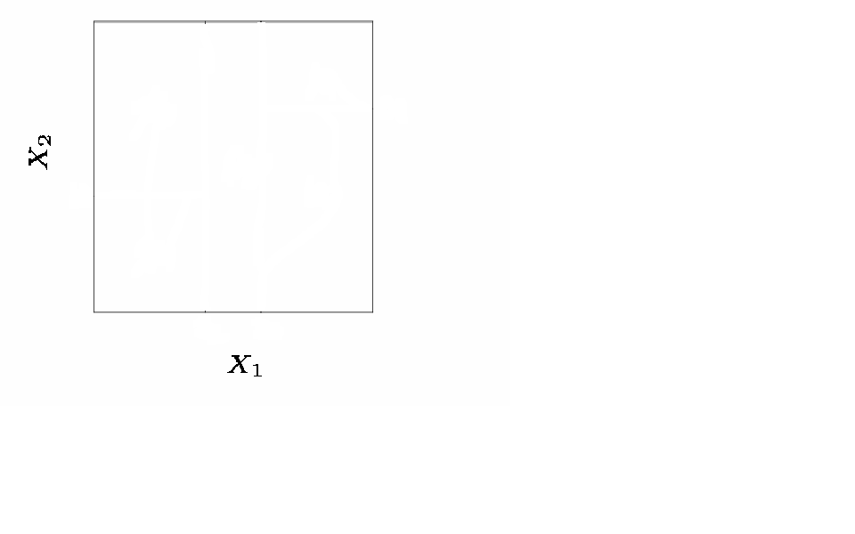
Splitting the X Variables
Generally we create the partitions by iteratively splitting one of the X variables into two regions

Slide 7
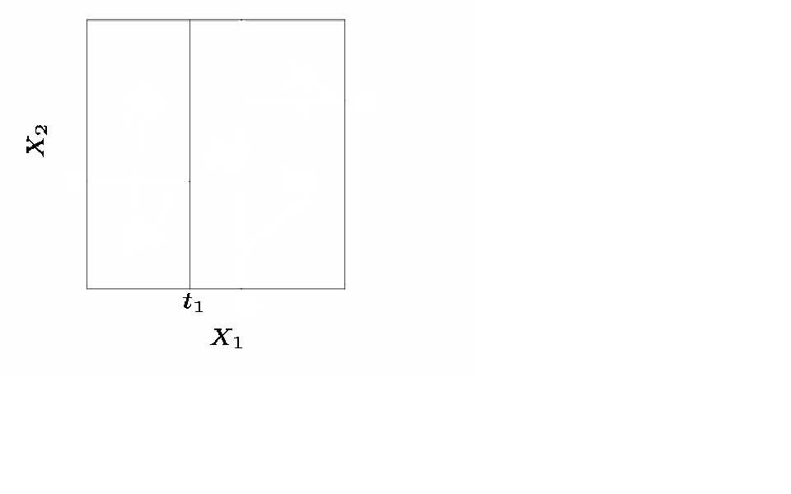
Splitting the X Variable
First split on X₁=t₁

Slide 8
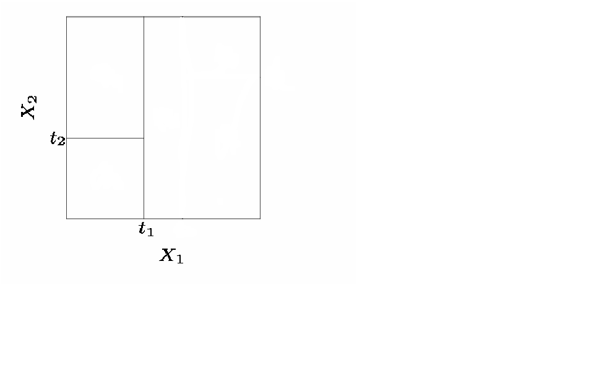
Splitting the X Variable
First split on X₁=t₁
If X₁<t₁, split on X₂=t₂

Slide 9
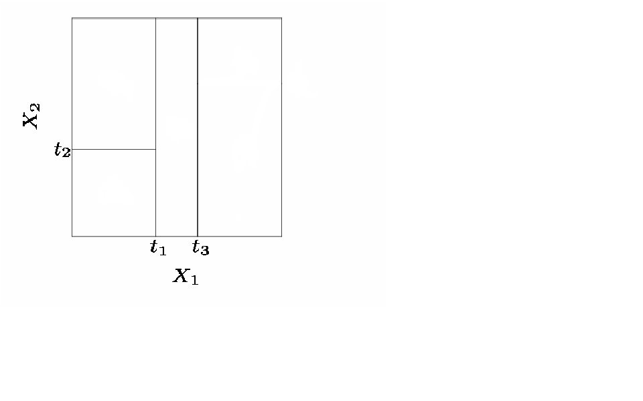
Splitting the X Variable
First split on X₁=t₁
If X₁<t₁, split on X₂=t₂
If X₁>t₁, split on X₁=t₃

Slide 10
Splitting the X Variable
First split on X₁=t₁
If X₁<t₁, split on X₂=t₂
If X₁>t₁, split on X₁=t₃
If X₁>t₃, split on X₂=t₄

Slide 11
Splitting the X Variable
When we create partitions this way we can always represent them using a tree structure.
This provides a very simple way to explain the model to a non-expert i.e. your boss!

Slide 12
Example: Baseball Players’ Salaries
The predicted Salary is the number in each leaf node. It is the mean of the response for the observations that fall there
Note that Salary is measured in 1000s, and log-transformed
The predicted salary for a player who played in the league for more than 4.5 years and had less than 117.5 hits last year is

Slide 13
Another way of visualizing the decision tree…

Slide 14
Some Natural Questions
Where to split? i.e. how do we decide on what regions to use i.e. R₁, R₂,…,R_{k} or equivalently what tree structure should we use?
What values should we use for ?

Slide 15
1. What values should we use for ?
Simple!
For region R_{j}, the best prediction is simply the average of all the responses from our training data that fell in region R_{j}.

Slide 16
2. Where to Split?
We consider splitting into two regions, X_{j}>s and X_{j}<s for all possible values of s and j.
We then choose the s and j that results in the lowest MSE on the training data.

Slide 17
Where to Split?
Here the optimal split was on X₁ at point t₁.
Now we repeat the process looking for the next best split except that we must also consider whether to split the first region or the second region up.
Again the criteria is smallest MSE.

Slide 18
Where to Split?
Here the optimal split was the left region on X₂ at point t₂.
This process continues until our regions have too few observations to continue e.g. all regions have 5 or fewer points.

Slide 19
Growing a Classification Tree
A classification tree is very similar to a regression tree except that we try to make a prediction for a categorical rather than continuous Y.
For each region (or node) we predict the most common category among the training data within that region.
The tree is grown (i.e. the splits are chosen) in exactly the same way as with a regression tree except that minimizing MSE no longer makes sense.
There are several possible different criteria to use such as the “gini index” and “cross-entropy” but the easiest one to think about is to minimize the error rate.

Slide 20
Example: Orange Juice Preference
Training Error Rate = 14.75%
Test Error Rate = 23.6%

Slide 21
Improving Tree Accuracy
A large tree (i.e. one with many terminal nodes) may tend to over fit the training data in a similar way to neural networks without a weight decay.
Generally, we can improve accuracy by “pruning” the tree i.e. cutting off some of the terminal nodes.
How do we know how far back to prune the tree? We use cross validation to see which tree has the lowest error rate.

Slide 22
Example: Baseball Players’ Salaries
The minimum cross validation error occurs at a tree size of 3

Slide 23
Example: Baseball Players’ Salaries

Slide 24
Example: Baseball Players’ Salaries
Cross Validation indicated that the minimum MSE is when the tree size is three (i.e. the number of leaf nodes is 3)

Slide 25
Example: Orange Juice Preference
Pruned Tree
CV Tree Error Rate = 22.5%
Full Tree Training Error Rate = 14.75%
Full Tree Test Error Rate = 23.6%

Slide 26
Trees vs. Linear Models
Which model is better?
If the relationship between the predictors and response is linear, then classical linear models such as linear regression would outperform regression trees
On the other hand, if the relationship between the predictors is non-linear, then decision trees would outperform classical approaches

Slide 27
Trees vs. Linear Model: Classification Example
Top row: the true decision boundary is linear
Left: linear model (good)
Right: decision tree
Bottom row: the true decision boundary is non-linear
Left: linear model
Right: decision tree (good)

Slide 28
Pros and Cons of Decision Trees
Pros:
Trees are very easy to explain to people (probably even easier than linear regression)
Trees can be plotted graphically, and are easily interpreted even by non-expert
They work fine on both classification and regression problems
Cons:
Trees don’t have the same prediction accuracy as some of the more complicated approaches that we examine in this course

Slide 29
Ensembles
Bagging
Bootstrapping
Bagging for Regression Trees
Bagging for Classification Trees
Out-of-Bag Error Estimation
Variable Importance: Relative Influence Plots
Random Forests

Slide 30
Problem!
Decision trees discussed earlier suffer from high variance!
If we randomly split the training data into 2 parts, and fit decision trees on both parts, the results could be quite different
We would like to have models with low variance
To solve this problem, we can use bagging (bootstrap aggregating).

Slide 31
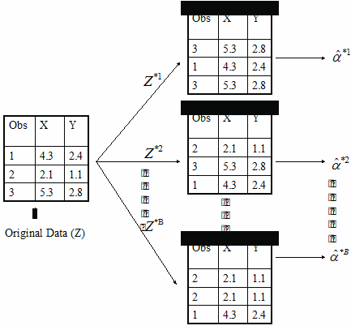
Bootstrapping is simple!
Resampling of the observed dataset (and of equal size to the observed dataset), each of which is obtained by random sampling with replacement from the original dataset.

Slide 32
What is bagging?
Bagging is an extremely powerful idea based on two things:
Averaging: reduces variance!
Bootstrapping: plenty of training datasets!
Why does averaging reduces variance?
Averaging a set of observations reduces variance. Recall that given a set of n independent observations Z₁, …, Z_{n}, each with variance , the variance of the mean of the observations is given by

Slide 33
How does bagging work?
Generate B different bootstrapped training datasets
Train the statistical learning method on each of the B training datasets, and obtain the prediction
For prediction:
Regression: average all predictions from all B trees
Classification: majority vote among all B trees

Slide 34
Bagging for Regression Trees
Construct B regression trees using B bootstrapped training datasets
Average the resulting predictions
Note: These trees are not pruned, so each individual tree has high variance but low bias. Averaging these trees reduces variance, and thus we end up lowering both variance and bias

Slide 35
Bagging for Classification Trees
Construct B regression trees using B bootstrapped training datasets
For prediction, there are two approaches:
Record the class that each bootstrapped data set predicts and provide an overall prediction to the most commonly occurring one (majority vote).
If our classifier produces probability estimates we can just average the probabilities and then predict to the class with the highest probability.
Both methods work well.

Slide 36
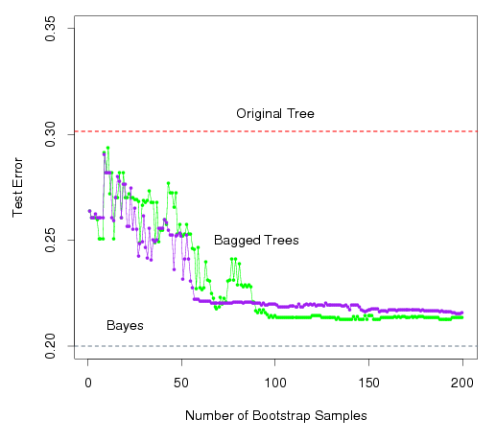
A Comparison of Error Rates
Here the green line represents a simple majority vote approach
The purple line corresponds to averaging the probability estimates.
Both do far better than a single tree (dashed red) and get close to the Bayes error rate (dashed grey).

Slide 37
Example 1: Housing Data
The red line represents the test mean sum of squares using a single tree.
The black line corresponds to the bagging error rate

Slide 38
Example 2: Car Seat Data
The red line represents the test error rate using a single tree.
The black line corresponds to the bagging error rate using majority vote while the blue line averages the probabilities.

Slide 39
Out-of-Bag Error Estimation
Since bootstrapping involves random selection of subsets of observations to build a training data set, then the remaining non-selected part could be the testing data.
On average, each bagged tree makes use of around 2/3 of the observations, so we end up having 1/3 of the observations used for testing

Slide 40
Variable Importance Measure
Bagging typically improves the accuracy over prediction using a single tree, but it is now hard to interpret the model!
We have hundreds of trees, and it is no longer clear which variables are most important to the procedure
Thus bagging improves prediction accuracy at the expense of interpretability
But, we can still get an overall summary of the importance of each predictor using Relative Influence Plots

Slide 41
Relative Influence Plots
How do we decide which variables are most useful in predicting the response?
We can compute something called relative influence plots.
These plots give a score for each variable.
These scores represents the decrease in MSE when splitting on a particular variable
A number close to zero indicates the variable is not important and could be dropped.
The larger the score the more influence the variable has.

Slide 42
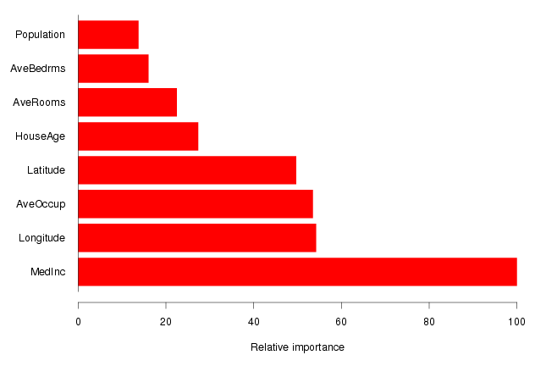
Example: Housing Data
Median Income is by far the most important variable.
Longitude, Latitude and Average occupancy are the next most important.

Slide 43
Random Forests
It is a very efficient statistical learning method
It builds on the idea of bagging, but it provides an improvement because it de-correlates the trees
How does it work?
Build a number of decision trees on bootstrapped training sample, but when building these trees, each time a split in a tree is considered, a random sample of m predictors is chosen as split candidates from the full set of p predictors (Usually )

Slide 44
Why are we considering a random sample of m predictors instead of all p predictors for splitting?
Suppose that we have a very strong predictor in the data set along with a number of other moderately strong predictor, then in the collection of bagged trees, most or all of them will use the very strong predictor for the first split!
All bagged trees will look similar. Hence all the predictions from the bagged trees will be highly correlated
Averaging many highly correlated quantities does not lead to a large variance reduction, and thus random forests “de-correlates” the bagged trees leading to more reduction in variance

Slide 45
Random Forest with different values of “m”
Notice when random forests are built using m = p, then this amounts simply to bagging.

Slide 46
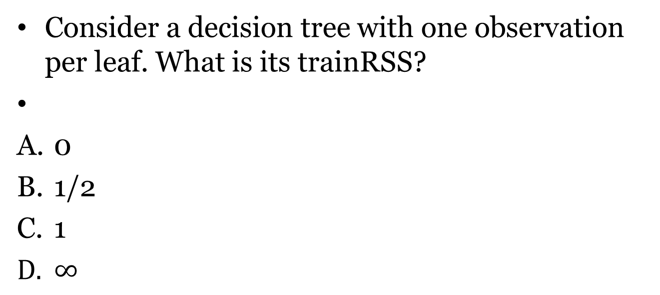
Final practice. Qualitative. 1
Consider a decision tree with one observation per leaf. What is its trainRSS?
0
1/2
1
$∞$

Slide 47
Final practice. Qualitative. 2
What is a random forest?
A model, consisting of many logistic regressions
An ensemble model, exploiting many decision trees.
Another name of decision trees algorithm.
An ensemble model, exploiting many linear regressions.

Slide 48
Final practice. Python. 1
Consider the following code:
from sklearn.tree import DecisionTreeRegressor
regressor = DecisionTreeRegressor(random_state = 0)
regressor.fit(X, y)
What does random_state = 0 mean in DecisionTreeRegressor constructor?
A randomly generated dataset will be used.
The dataset that will be later given to DecisionTreeRegressor object, will be used without random sorting
The dataset that will be later given to DecisionTreeRegressor object, will be randomly sorted
The seed for later random operations on the DecisionTreeRegressor, is fixed to a zero value.

Slide 49
Final practice. Python. 2
Consider the following code
dt = DecisionTreeRegressor(max_depth=8, min_samples_leaf=0.13, random_state=3)
What does the min_samples_leaf parameter mean?
The minimum number of observations, required to split an internal node
The minimum number of observations, required to be at a leaf node
The minimum depth of the tree.
The minimum number of leaves.

Slide 50
Final practice. Python. 3
Consider the following code:
from sklearn.ensemble import RandomForestClassifier
model = RandomForestClassifier(n_estimators=100,
bootstrap = True,
max_features = 'sqrt')
What is n_estimators parameter there?
Power of algorithm
Duration of execution
Number of trees in the forest
Number of features to consider when looking for the best split

Slide 51
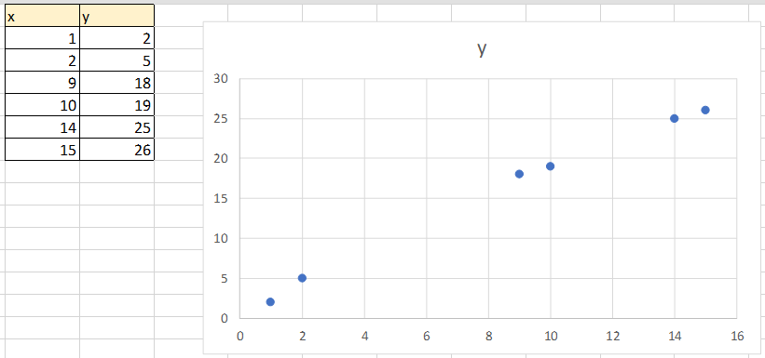
Final practice. Quantitative. Regression tree
You need to deal with the following data

Slide 52
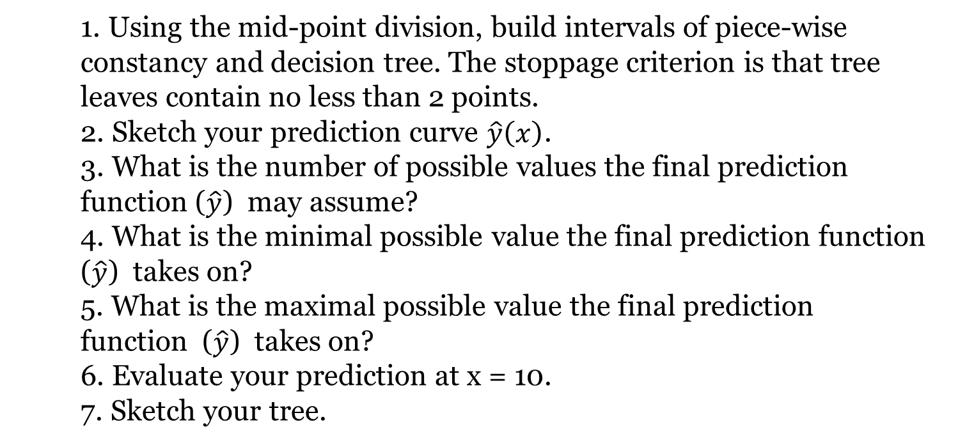
Final practice. Quantitative. Regression tree (continued)
Using the mid-point division, build intervals of piece-wise constancy and decision tree. The stoppage criterion is that tree leaves contain no less than 2 points.
Sketch your prediction curve $\hat{y}\left(x\right)$.
What is the number of possible values the final prediction function ($\hat{y}$) may assume?
What is the minimal possible value the final prediction function ($\hat{y}$) takes on?
What is the maximal possible value the final prediction function ($\hat{y}$) takes on?
Evaluate your prediction at x = 10.
Sketch your tree.

Slide 53
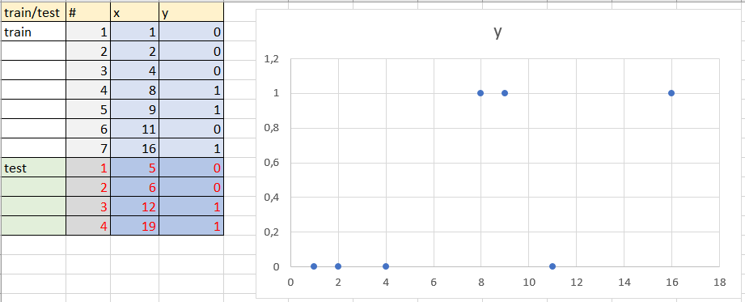
Final practice. Quantitative. Classification tree

Slide 54
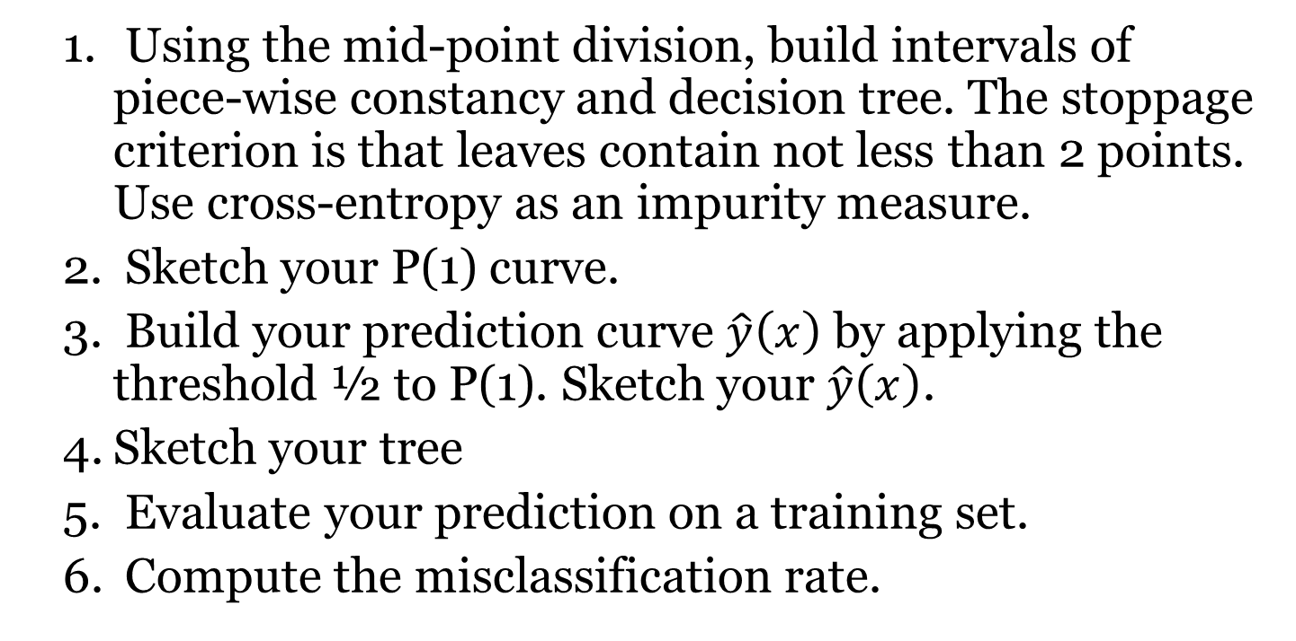
Final practice. Quantitative. Classification tree (continued)
Using the mid-point division, build intervals of piece-wise constancy and decision tree. The stoppage criterion is that leaves contain not less than 2 points. Use cross-entropy as an impurity measure.
Sketch your P(1) curve.
Build your prediction curve $\hat{y}\left(x\right)$ by applying the threshold ½ to P(1). Sketch your $\hat{y}\left(x\right)$.
Sketch your tree
Evaluate your prediction on a training set.
Compute the misclassification rate.

